Slide 1
A study on the detection and validation of Protein-Protein Interaction Inhibitors for Cystic Fibrosis treatment using AI-driven virtual screening approach
DOCTORAL ADVISORY COMMITTEE MEETING
Date:
Research Guide:
Dr. Manoov Rajapandy
Senior Assistant Professor
Department of Computer Science and Engineering
Vellore Institute of Technology
Vellore
Research Scholar:
Ms. Dhivya Gunasekaran
24PDT0002
School of Biosciences and Technology
Vellore Institute of Technology
Vellore

Slide 2
Research Profile
Skills in Bio-informatics
Participated in ‘Training on Bioinformatics’ held from 24th June to 1st July 2006 at Sai’s Biosciences Research Institute Pvt Ltd.
Participated in ‘Industrial training program & Wetlab Training for Bioinformatics’ conducted by NIOT from 19th June to 23rd June 2006.
Participated in National workshop on Bioinformatics held on 25th March 2006 Arunai Engineering college, Thiruvannamalai.
Journal Publications
Dhivya Gunasekaran, N. Chandrasekaran, David F L Jenkins. “Plain polysterene microplastics reduce the toxic effects of ZnO particles on marine microalgae Dunaliella salina”. Journal of Environmental Chemical Engineering 8(5), 104250, 2020
Sekar kumaran, Gunasekaran Dhivya “Phytoremediation of heavy metals (Cu. Pb, Zn, Cr) on Golden doranda, Balsam & Erwa plants” Journal of chemical and pharmaceutical research 2013,5(12):1500-1511

Slide 3
Contents
Introduction and Background
Literature survey
Novelty
Hypothesis
Research questions
Objectives
Work Plan
Proposed Course work

Slide 4
Introduction and Background
Cystic Fibrosis (CF) is a fatal hereditary condition marked by thicker mucus production, which can cause problems with respiratory systems (Biswajit et al 2024).
CF patients with chronic lung infections are most common with significant pathogen, Pseudomonas aeruginosa (Pa).
Cystic fibrosis transmembrane conductance regulator (CFTR) protein is encoded by a defective gene on chromosome 7 which leads to life-threatening lung infections (Rowe et al 2005).
CF is a severe, life-limiting genetic disorder caused by mutations in the CFTR gene, leading to dysfunctional CFTR protein and impaired ion transport (Biswajit et al 2024). .
The chronic nature of CF leads to repeated courses of potentially toxic drugs for many years, increasing the risk of side eﬀects, such as drug resistance, impairment of renal function and hearing (Flume et al., 2007).
The quality of life and survival rates of CF patients can be improved by early identification and individualized therapy measures.

Slide 5
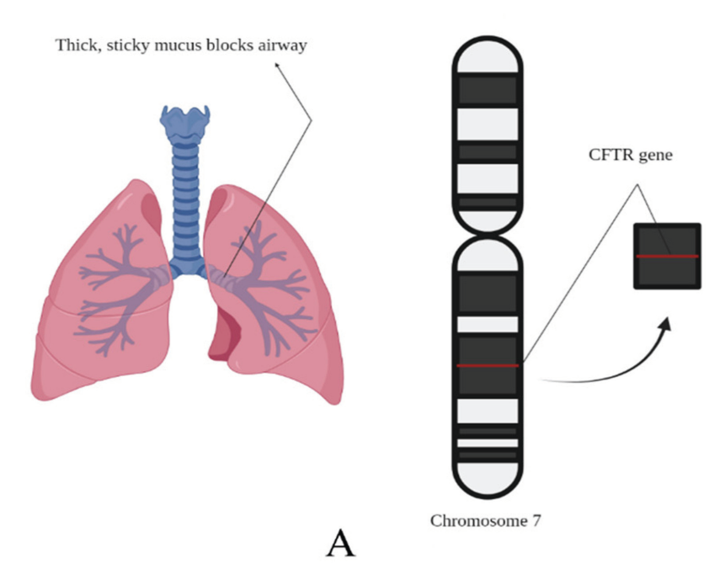
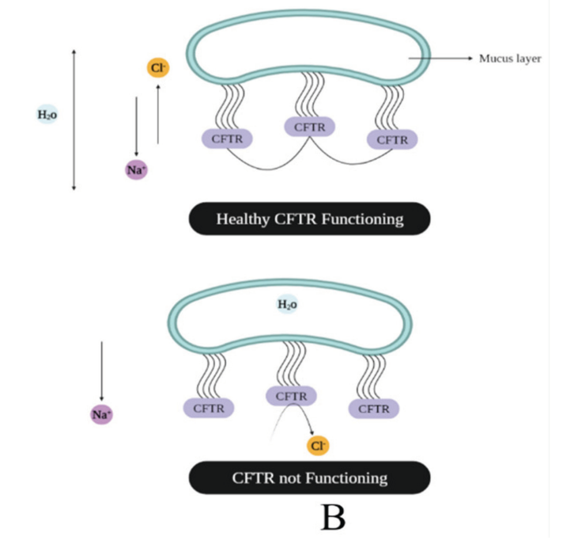
Why Cystic fibrosis?
(A) Cystic fibrosis and the CFTR gene in chromosome seven whose malfunction is responsible for the disease.
(B) Functioning of healthy and unhealthy CFTR

Slide 6
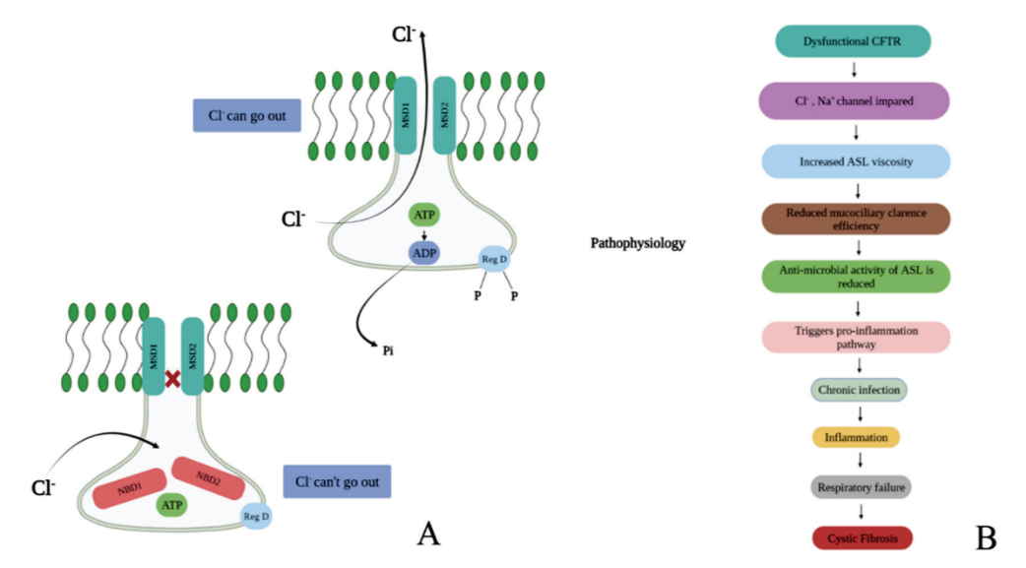
Dysfunctional CFTR
Cl-, Na+ channel impaired
Increased ASL vicosity
Reduced mucocillary clearance efficiency
Anti-microbial activity of ASL is reduced
Triggers pro-inflammation pathway
Chronic infection
Inflammation
Respiratory failure
Normal CFTR in which the Cl- can pass; as a result, the concentration and ASL viscosity are maintained, and when Cl- cannot pass, CF can be caused
Cystic fibrosis
(B) pathophysiological process.

Slide 7
Protein–protein interactions (PPIs)
Protein–protein interactions (PPIs) play a crucial role in CFTR misfolding, degradation, and defective trafficking, particularly in the F508del mutation (Sirvani et al., 2015).
F508del mutation - Inappropriate modifications after translation are thought to be the cause of a protein's inability to be bound to the proper cellular site.
Existing treatments like Lumacaftor and Ivacaftor have limited efficiency, high cost, and variable patient response, highlighting the need for new therapeutics.
Enzymes, ion channels, and receptors are the most common proteins for target-based drug discovery (Santos etal, 2017).
Proteins are part of signaling pathways and multisubunit complexes (Vidal et al., 2011). Their macromolecular interactions such as protein–DNA and protein–protein interactions (PPIs) are key targets to expand the druggable proteome (Lu et al., 2020).
Protein–protein interactions (PPIs) offer great opportunities to expand the druggable proteome and therapeutically tackle various diseases (Philipp et al., 2024).
PPI-targeting drugs provides advantages over other types of drugs such as vaccines or antivirals circumventing mutations in the pathogens/genomes that can result in immune evasive properties.

Slide 8
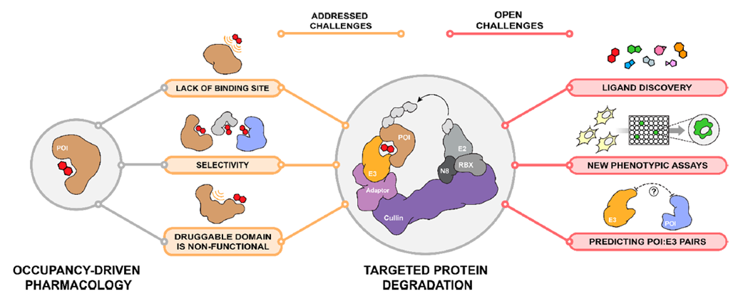
Actions of cystic fibrosis transmembrane conductance regulator (CFTR) modulators as correctors and potentiators

Slide 9
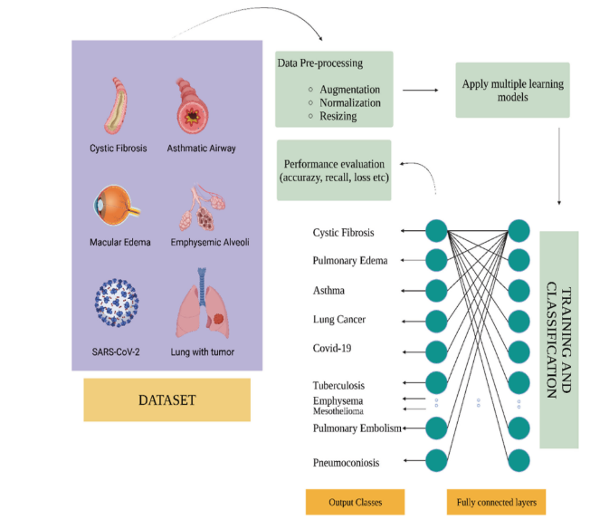
Importance of ML in Cystic Fibrosis
Machine learning (ML) have emerged as powerful tools in virtual screening and drug discovery but are under utilized in identifying PPI inhibitors for CF.
This study proposes developing an ML-driven platform for predicting, screening, and validating novel PPI inhibitors for cystic fibrosis treatment.
ML based algorithms are revolutionizing CF diagnosis by utilizing huge genetic, clinical, and imaging databases.
Fig. (2). The usefulness of AI in CF.

Slide 10
CFTR-Interacting Proteins for Targeting PPI Inhibitor
Protein | Full Name | Biological Role | Relevance to CFTR & PPI Targeting
HSP90 | Heat Shock Protein 90 | Molecular chaperone that stabilizes folding intermediates | Stabilizes misfolded CFTR; inhibition may alter folding trajectory and degradation outcomes
STIP1 | Stress-Induced Phosphoprotein 1 | Co-chaperone linking HSP70 and HSP90 in CFTR folding complexes | Mediates CFTR chaperone complex; PPI disruption may modulate folding pathway
CAL | CFTR-Associated Ligand | Adaptor protein promoting CFTR degradation via lysosomal trafficking | Competes with NHERF1 for CFTR binding; inhibition could prolong CFTR membrane stability

Slide 11
Literature Survey
Author | Year | Title | Journal | Relevant Research Gap | Key findings
Tang W etal | 2024 | In silico discovery of potential PPI inhibitors for anti-lung cancer activity | Frontiers in Chemistry | AI/ML-driven in silico workflow for PPI inhibitor identification and validation | Developed a workflow integrating pharmacophore modeling, virtual screening, molecular dynamics, and MM-GBSA to identify potential PPI inhibitors.
Philipp etal | 2024 | AI-guided pipeline for protein–protein interaction drug discovery identifies a SARS-CoV-2 inhibitor | Molecular Systems Biology | Lack of integrated AI pipelines for PPI-targeted drug discovery | Created an AI-ML workflow integrating AlphaFold-Multimer and ultra-large virtual screening for novel PPI inhibitors.
Deborah etal | 2022 | Drug Design by Pharmacophore and Virtual Screening Approach | Pharmaceuticals | Lack of validated workflows combining pharmacophore modeling with docking, ADMET, and MD simulations. | Pharmacophore models are effective in drug discovery (structure & ligand-based), Validation (GH score, ROC-AUC) improves reliability, Integration with docking and ADMET filtering improves hit accuracy
Duran etal | 2023 | Advancing Targeted Protein Degradation via Multiomics Profiling and Artificial Intelligence | Journal of the American Chemical Society | Limited druggability of PPIs and undruggable targets; absence of AI-guided degrader design strategies | AI/ML integrated with chemoproteomics enables rational design of PROTACs/MGDs; proposed AI frameworks to predict effective POI-ligase pairs for degrader design.
Tang etal | 2023 | Developing Adaptive Personalized Therapy for Cystic Fibrosis Using Reinforcement Learning | Annals of Applied Statistics | Need for adaptive, individualized CF treatment strategies over time | Reinforcement learning (Q-learning) effectively models personalized, multistage CF therapy; supports dynamic AI-driven clinical decisions.

Slide 12
Author | Year | Title | Journal | Relevant Research Gap | Key findings
Alaa etal | 2018 | Prognostication and Risk Factors for Cystic Fibrosis via Automated Machine Learning | Scientific Reports | Limitations of traditional CF prognostic models; poor integration of multi-factor clinical data | AutoML framework (AutoPrognosis) improves CF outcome prediction and identifies novel clinical risk factors; useful for future drug-response prediction modeling.
Cholon etal | 2022 | Established and Novel Human Translational Models to Advance CF Research | Current Opinion in Pharmacology | Limited models for rare CFTR mutations; need for personalized screening systems | Describes use of organoids, iPSC, and nasal/bronchial cultures for drug screening; enables testing of CFTR-targeting drugs and potential PPI disruptors.
Allen etal | 2023 | Future Therapies for Cystic Fibrosis | Nature Communications | CFTR modulators ineffective for many rare variants; need for mutation-agnostic strategies | Highlights gene editing, RNA-based approaches, and delivery challenges; underscores need for AI-guided discovery for hard-to-target CFTR mutations.
Biswajit etal | 2024 | The Future of CF Care: Exploring AI’s Impact on Detection and Therapy | Current Respiratory Medicine Reviews | Lack of integrated AI tools for personalized CF therapy and drug repurposing | AI enables drug repurposing, mutation-specific therapy, and imaging-based diagnostics; proposes AI-based stratification for CFTR-targeted therapy pipelines.

Slide 13
Hypothesis
ML-driven Virtual screening and Machine learning models can accurately identify and prioritize small-molecule inhibitors targeting CFTR-associated PPIs for Cystic fibrosis treatment.
Research Question
Can Machine learning-based virtual screening effectively detect and rank potential PPI inhibitors for CFTR-associated interactions in Cystic fibrosis?

Slide 14
Objectives
Aim
To identify CFTR-associated PPI inhibitors using AI-driven virtual screening for novel cystic fibrosis therapeutics.
To develop an AI-driven virtual screening platform for identifying PPI inhibitors targeting CFTR-related interactions in cystic fibrosis.
To validate shortlisted inhibitors through Molecular docking, Molecular dynamics simulations, and binding free energy calculations.
To apply Machine learning models for predicting and ranking small molecules based on binding affinity, interaction profiles, and therapeutic potential.
To evaluate ADMET and pharmacokinetic profiles of lead compounds using ML-based predictive tools for safety and drug-likeness.

Slide 15
Objective 1:
To develop an ML-driven Virtual screening platform for identifying PPI inhibitors targeting CFTR-related interactions in Cystic fibrosis.
Previous Research:
Trepte et al. (2024) - AI guided pipeline for prioritizing and targeting protein–protein interactions.
Proposed Methodology:
Collect CFTR and PPI datasets (PDB)
Protein structure modelling and to predict missing complexes (AlphaFold)
Identify PPI interfaces
Develop supervised ML models (SVM) trained on known PPI modulators
Integrate models into virtual screening workflow to screen the compounds for its efficiency
Curated CFTR - PPI datasets, ML model selection
Expected Outcome:

Slide 16
Objective 2:
To validate shortlisted inhibitors through Molecular docking, Molecular dynamics simulations, and binding free energy calculations.
Previous Research:
Tang et al., (2024) - In silico discovery of potential PPIinhibitors for anti-lung canceractivity by targeting theCCND1-CDK4 complex via the P21 inhibition mechanism
Proposed Methodology:
Perform Molecular docking
(AutoDock Vina / Schrodinger Glide)
(GMX_MMPBSA)
Run Molecular Dynamics (MD) simulations (QM/MM Scoring)
Calculate free binding energies
Validated lead compounds with binding and interaction profiles
Expected Outcome:

Slide 17
Objective 3:
To apply Machine learning models for predicting and ranking small molecules based on binding affinity, interaction profiles, and therapeutic potential.
Previous Research:
Trepte et al. (2024) - AI guided pipeline for prioritizing and targeting protein–protein interactions.
Proposed Methodology:
Extract molecular descriptors and fingerprints using cheminformatics tools
Train ML models on datasets of PPI inhibitors
Validate models using metrics (accuracy, precision-recall)
Predict and rank candidate compounds by binding affinity and therapeutic potential
Prototype -based screening platform, top compound hits
Expected Outcome:

Slide 18
Objective 4:
To evaluate ADMET and pharmacokinetic profiles of lead compounds using AI-based predictive tools for safety and drug-likeness.
Previous Research:
Basu et al. (2024) – Cystic Fibrosis: AI in Prognosis and Drug Discovery
Proposed Methodology:
ADMET prediction
Pharmacokinetic assessment
Compound prioritization
(Safety, bioavailability, efficacy)
Shortlisted high-potential compounds
Expected Outcome:

Slide 19
Present work
Collection of Datasets: BIOGRID, PDB
Training the datasets using ML Model
Virtual Screening
Computational screening of molecules identifies potential drug candidates with high stability and specificity.
Molecular Docking
Selected molecules are docked into the binding region to predict binding orientation and interaction strength.

Slide 20
Completed Course Works
1. English (PENG504N)
Faculty: Dr. Laxmi Dhar Dvivedi
Credits: 3
Evaluation: Internal assessments, Quiz, Mini Project
Duration: 30 Hours
2. Research Publication and Ethics (PRMC0001L)
Faculty: Dr. Jayaraman G
Credits: 2
Evaluation: CAT I & II, Assignment, Case Study discussion, FAT
Duration: 30 Hours
3. Research Methodology for Sciences (PRES706L)
Faculty: Dr. Debashish Mishra
Credits: 4
Evaluation: CAT I & II, Quiz/Assignment, Seminar, FAT
Duration: 45 Hours

Slide 21
COURSE WORKS PLANNED
Guide Paper 1 : Computational Drug Discovery & Molecular Docking
Handled by: Dr. Manoov Rajapandy, SCOPE
Duration : 6-8 Weeks
Course Objectives:
Understand the principles of computational drug discovery.
Learn molecular docking and its applications in drug screening.
Gain expertise in molecular dynamics simulations for lead validation.
Explore cheminformatics tools for drug design.
Ability to perform molecular docking and analyze docking results.
Skill in using computational tools like AutoDock Vina, Schrödinger Glide, and GROMACS.
Competence in predicting drug-target interactions using structure-based approaches.

Slide 22
Module 1: Introduction to Drug Discovery
Principles of drug design and discovery, Role of computational methods in drug screening, Target-based vs. ligand-based drug discovery.
Module 2: Protein-Ligand Interactions
Molecular interactions: hydrogen bonding, hydrophobic interactions, Structural features of proteins and small molecules, Protein structure databases (PDB, UniProt).
Module 3: Molecular Docking Techniques
Basics of docking: rigid vs. flexible docking, Docking tools: AutoDock Vina, Schrödinger Glide, Scoring functions and binding affinity predictions.
Module 4: Molecular Dynamics Simulations
Force fields and energy minimization, MD software: GROMACS, AMBER, Free energy calculations (MM-PBSA, MM-GBSA).
Module 5: Virtual Screening Strategies
High-throughput screening (HTS), Ligand-based and structure-based screening, Computational validation of docking results.

Slide 23
Guide Paper 2: Python for AI-Driven Drug Discovery
Handled by: Dr. Manoov Rajapandy, SCOPE
Duration : 6-8 Weeks
Course Objectives:
Introduce Python programming fundamentals for computational drug discovery.
Apply Python libraries for cheminformatics, molecular docking, and machine learning.
Develop ML models for virtual screening and protein-ligand interactions.
Implement Python-based data analysis for drug candidate selection.

Slide 24
Module 1: Python Fundamentals for Drug Discovery
Python basics: data types, functions, loops, and file handling, Introduction to NumPy, Pandas, and Matplotlib, Data visualization and preprocessing for bioinformatics applications.
Module 2: Molecular Data Handling & Cheminformatics
RDKit for molecular fingerprinting and structure analysis, Open Babel for chemical format conversion, SMILES representation and molecular descriptor generation, Molecular similarity and clustering techniques.
Module 3: Machine Learning for Drug Discovery
Basics of supervised and unsupervised learning, Feature extraction for drug molecules, Deep learning models for protein-ligand binding (TensorFlow, PyTorch), Molecular property prediction using DeepChem.
Module 4: Virtual Screening & Molecular Docking
AutoDock and AutoDock Vina for docking simulations, Python scripts for virtual screening automation, Binding affinity prediction and interaction analysis, PyMOL for 3D molecular visualization.
Module 5: Pharmacokinetics & ADMET Prediction
pkCSM and SwissADME for ADMET analysis, Toxicity prediction models using Python, Machine learning-based drug-likeness prediction, Lead optimization strategies with Python.

Slide 25
NPTEL Course: Machine Learning & AI in Drug Discovery
Handled by:
Duration: 12 Weeks
Credits: 3
Course Objectives:
Learn fundamentals of machine learning and deep learning.
Understand AI-driven drug discovery techniques.
Develop models for virtual screening and ADMET prediction.
Proficiency in AI-based molecular property prediction.
Experience with ML frameworks (DeepChem, Chemprop). Knowledge of ML-driven de novo drug design techniques.

Slide 26
Week 1: Introduction to ML in Drug Discovery, Overview of ML in bioinformatics.
Week 2: Supervised vs. unsupervised learning, ML-driven compound screening.
Week 3: Feature Engineering & Molecular Representation, Molecular fingerprints and descriptors.
Week 4: Graph-based representation of molecules, Feature extraction using ChemBERTa and MolBERT.
Week 5: ML Algorithms for Drug Discovery, Neural networks, decision trees, and SVMs.
Week 6: Deep learning frameworks (DeepChem, Chemprop).
Week 7: Predicting drug-target interactions.
Week 8: Model Training & Evaluation, Dataset preparation and preprocessing.
Week 9: Cross-validation and performance metrics.
Week 10: Avoiding overfitting and bias in models.
Week 11: AI Applications in Drug Design, De novo drug design using generative models.
Week 12: AI-based toxicity prediction, Case studies in ML-driven drug discovery.

Slide 27
References
Basu, B., Dutta, S., Rahaman, M., Bose, A., Das, S., Prajapati, J., & Prajapati, B. (2024). The Future of Cystic Fibrosis Care: Exploring AI's Impact on Detection and Therapy. Current Respiratory Medicine Reviews, 20(4), 302-321.
Rowe, S. M., Miller, S., & Sorscher, E. J. (2005). Mechanisms of disease: cystic fibrosis. New England Journal of Medicine, 352(19), 1992-2001.
Flume, P. A., O’sullivan, B. P., Robinson, K. A., Goss, C. H., Mogayzel Jr, P. J., Willey-Courand, D. B., ... & Marshall, B. (2007). Cystic Fibrosis Foundation, Pulmonary Therapies Committee. Cystic fibrosis pulmonary guidelines: chronic medications for maintenance of lung health. Am J Respir Crit Care Med, 176(10), 957-969.
Siryani, I., Jama, M., Rumman, N., Marzouqa, H., Kannan, M., Lyon, E., & Hindiyeh, M. (2015). Distribution of cystic fibrosis transmembrane conductance regulator (CFTR) mutations in a cohort of patients residing in palestine. PloS one, 10(7), e0133890
Santos, R., Ursu, O., Gaulton, A., Bento, A. P., Donadi, R. S., Bologa, C. G., ... & Overington, J. P. (2017). A comprehensive map of molecular drug targets. Nature reviews Drug discovery, 16(1), 19-34.
Vidal, M., Cusick, M. E., & Barabási, A. L. (2011). Interactome networks and human disease. Cell, 144(6), 986-998.
Lu, H., Zhou, Q., He, J., Jiang, Z., Peng, C., Tong, R., & Shi, J. (2020). Recent advances in the development of protein–protein interactions modulators: mechanisms and clinical trials. Signal transduction and targeted therapy, 5(1), 213.

Slide 28
References
8. Trepte, P., Secker, C., Olivet, J., Blavier, J., Kostova, S., Maseko, S. B., ... & Wanker, E. E. (2024). AI-guided pipeline for protein–protein interaction drug discovery identifies a SARS-CoV-2 inhibitor. Molecular systems biology, 20(4), 428-457.
9. Luise, C., & Robaa, D. (2018). Application of virtual screening approaches for the identification of small molecule inhibitors of the methyllysine reader protein Spindlin1. Rational Drug Design: Methods and Protocols, 347-370.
10. Danel, T., Łęski, J., Podlewska, S., & Podolak, I. T. (2023). Docking-based generative approaches in the search for new drug candidates. Drug Discovery Today, 28(2), 103439.
11. Tang, W., Shen, T., & Chen, Z. (2024). In silico discovery of potential PPI inhibitors for anti-lung cancer activity by targeting the CCND1-CDK4 complex via the P21 inhibition mechanism. Frontiers in Chemistry, 12, 1404573.
12. Sobral, P. S., Luz, V. C., Almeida, J. M., Videira, P. A., & Pereira, F. (2023). Computational approaches drive developments in immune-oncology therapies for PD-1/PD-L1 immune checkpoint inhibitors. International Journal of Molecular Sciences, 24(6), 5908.
13. Cooke, L. (2023). AlphaFold: protein structure predictions that will revolutionise medicine. Royal College of Surgeons in Ireland Student Medical Journal, (1), 71-76.
14. Lebecque, P., & Stanescu, D. (1997). Respiratory resistance by the forced oscillation technique in asthmatic children and cystic fibrosis patients. European Respiratory Journal, 10(4), 891-895.

Slide 29

WE WON’T STOP
UNTIL
CF STANDS FOR CURE FOUND

Slide 30
MTech Course: Machine Learning in Drug Discovery
Handled by:
Duration: 12 Weeks
Credits: 3
Course Objectives:
Learn fundamentals of machine learning and deep learning. Understand ML-driven drug discovery techniques. Develop models for virtual screening and ADMET prediction. Proficiency in ML-based molecular property prediction. Experience with ML frameworks (DeepChem, Chemprop). Knowledge of ML-driven de novo drug design techniques.
Module 1: Introduction to ML in Drug Discovery
Overview of ML in bioinformatics, Supervised vs. unsupervised learning, ML-driven compound screening
Module 2: Feature Engineering & Molecular Representation
Molecular fingerprints and descriptors, Graph-based representation of molecules, Feature extraction using ChemBERTa and MolBERT
Module 3: ML Algorithms for Drug Discovery
Neural networks, decision trees, and SVMs, Deep learning frameworks (DeepChem, Chemprop), Predicting drug-target interactions
Module 4: Model Training & Evaluation
Dataset preparation and preprocessing, Cross-validation and performance metrics, Avoiding overfitting and bias in models
Module 5: AI Applications in Drug Design
De novo drug design using generative models, AI-based toxicity prediction, Case studies in ML-driven drug discovery

